Slide 1
eFACTS Applications education 2016-01-15
Jean-Philippe Abeillon, Martin Svennungsson
Notes:
JPA – additional changes:
Replacement of Volvo 3P by Volvo GTT

Slide 2
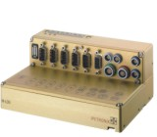

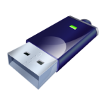
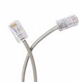
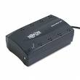

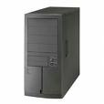


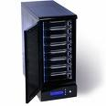

Electronics FAults CapTuring System
In Vehicle
Logger System
Data Transfer Via USB,
Ethernet, WLAN or 3G.
Volvo IT
Oracle DataBase
Key/Meta Data
Local Data Collector
Raw Data
Automated Upload
Application Server
WEB Search App.
System Service
Converter Service
Data Refiner App.
Adding search keys and comments
Test Administrator
Search Parameters
Mass Storage
(Net Disc)
Data. (CANalyzer format)

Slide 3
RDM Logger/Vehicle binding
DDC server
Ultra modem/
RDM
MLOG
If activated by TT
Will only send data if GPRS coverage and after next M-LOG restart
eFACTS server
Collector Logger/Vehicle binding
RAW - Button triggered event → PROTUS data
Test Engineer must handle this
Refiner
Data not recognized
Collector
Autotriggered External signal recording data e.g tempsensor or J1939/LIN/J1587 or Autotriggered data
recognized using unique MeasTopic-GUID
External Data Import
Tool
Organizer (server app)
EEE
Safety server
Autotriggered event
Safety triggered data

Slide 4
PC Prerequisites
”Open Client” for MyPlace computers (FAROS)
GOT users
Send mail to Martin
When confirmed, use motivation sent by Martin
Oracle SQLNet64 client (FAROS)
Contact TFV team for installation and education => support.efacts@volvo.com
USB stick for data retrieval

Slide 5
eFACTS Collector – Upload of logger data

Slide 6

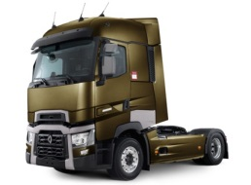



eFACTS Collector
2 Main objectives
- Binding between the datalogger serial number and the truck it is in
- Upload Data to the Server
Oracle DataBase
Key/Meta Data
Local Data Collector
Raw Data
Automated Upload
Mass Storage
(Net Disc)
Notes:
Risk: Sending logged data to the wrong truck!! (If binding is not updated).

Slide 7
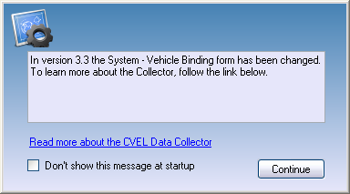
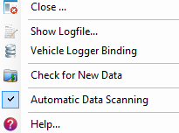
eFACTS Collector
When opened, a status window gives general information and a link to the application help: (this window can be deactivated if the checkbox is checked)
Then, an icon appears in the Windows system tray next to the clock
A right click in this icon opens a pop-up menu

Slide 8
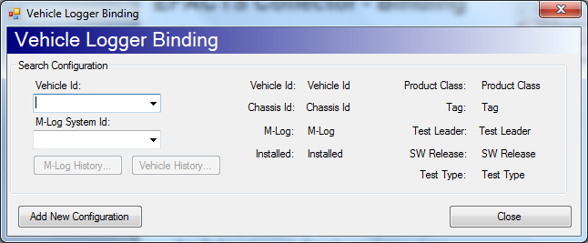
eFACTS Collector - Binding
Click on the Vehicle Logger Binding option
You can either select a Logger ID or a Truck ID
The current binding parameters are displayed
Then you can have a look of the binding history for the selected item
(Note! When adding a new Logger or Vehicle id, they will initially not be seen in the drop-down list, but you can enter the id manually to search for it).

Slide 9
eFACTS Collector - Binding
What if the binding has to be changed?
e.g. moved logger to new vehicle, new test type, new SW in the vehicle, etc-
=> Click on Add New Configuration

Slide 10
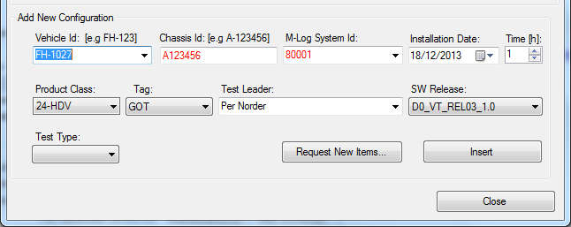
eFACTS Collector – Add New Binding
Select a truck
Current binding should be displayed
Choose a SW, a Test Leader, a Site (Tag), a test type and an installation date
Chassis ID and M-LOG ID names are controlled and must NOT be displayed in RED

Slide 11
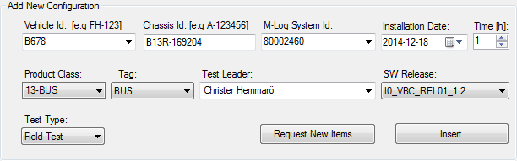
eFACTS Collector – Add New Binding
Fields without a grey back-ground can be entered by each user
(e.g. Vehicle id, Chassis id etc
Request New Items
Use if you can’t find the correct values in the greyed drop down lists
Insert
When you entered all value, you have to press ”Insert” to upload the new binding to the database

Slide 12
Collector – Binding - Recommendations
Product Class is a critical field. Please check with PROTUS which Product Class the Truck belongs to.
The PC filters the Truck Functions that will be seen in Refiner.
Product Class, TAG, SW and Test type lists are locked. Please contact support for more items.
/!\ DO NOT try to add a configuration with an old Starting date or between 2 existing configurations, it will mess the database up!! => Contact support.efacts@volvo.com if you did an incorrect binding.
If you want to add or update (e.g. SW Package) for old vehicle binding configurations, ask support - (email or Click on the Request for New Items button in the Collector window)

Slide 13
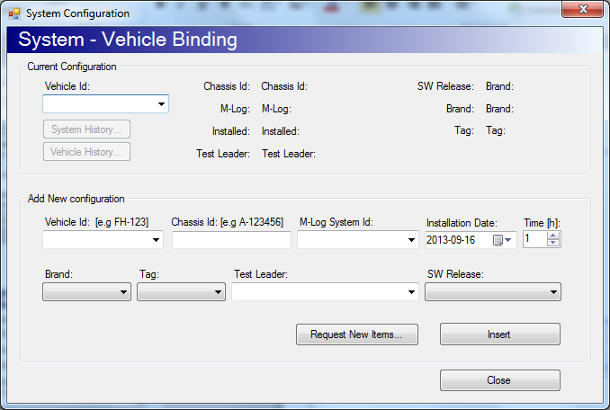
Collector DON’Ts
Top part is for SEARCH
Buttom for CHANGES
The keys in the Collector end up as keys in Refiner. (SW, TL)
If you update, close and re-open windows, as you might change for another truck.
Installation date is the date when the system was INSTALLED or when the SW (all keys) was changed (in the truck).
Avoid to send same MEA-data again, ask Support E-FACTS if you can’t find your data. (Copy detected will be shown).
When problem, send ”Show Log file...” to Support E-FACTS.

Slide 14
eFACTS Collector – Upload Data
You can get data from several loggers in the same way as one.
The data structure on the USB-stick will be:
8000xxxx
8000yyyy
8000zzzz (one folder per M-LOG datalogger serial number)

Slide 15
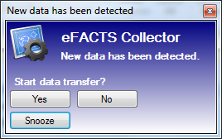
eFACTS Collector – Upload Data
Confirm that the binding in Collector is correct
Copy all data from the logger (8000xxxx folder) to C:\MeasData
This popup should appear
/!\ WAIT FOR THE COMPLETED COPY BEFORE CLICKING YES (USB Stick LED not flashing)
Once Yes button is clicked, data will be transferred to the server when a VCN connection is present.
The data transfer rate to the server is dependent from the quality of the connection /!\ In case of a MyAccess Connection /!\

Slide 16
eFACTS Collector – Upload Data
If this window does not appear, you are in Manual mode
Then Choose Check for New Data in the context menu of Collector icon (Notification area of the taskbar)
You can check the Automatic Data Scanning option for next time if you want to
Data that is not recognized by the server is rejected and will be moved to C:\eFACTS\Collector\Rejected and has to be handled manually by the user
Upload and transfer procedure: see next slides

Slide 17
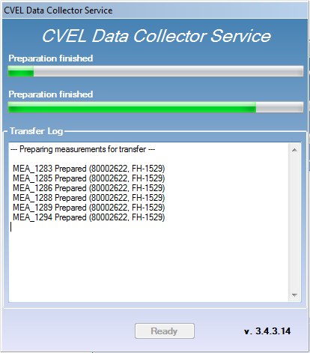
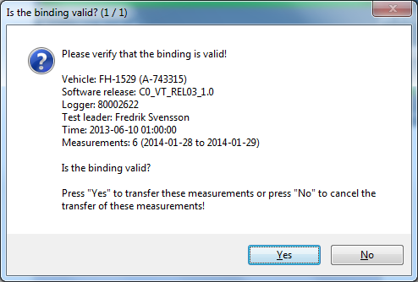
eFACTS Collector – data upload
When the preparation of the MEA-packages is done, a pop-up window (like above) will show which truck the data will be sent to.
Make sure that all the information is correct, if not select ”No” and change vehicle/logger bindings in Collector

Slide 18
eFACTS Collector – data transfer Check Vehicle Logger Binding
1. Check Vehicle
2. Check Software Release
3. Check Test Leader
Info MEA-packages - How many
- Start date and End date
Press No if incorrect binding info
Update the binding using Collector
If you have data from several loggers in C:\MeasData, you will get one window for each truck binding

Slide 19
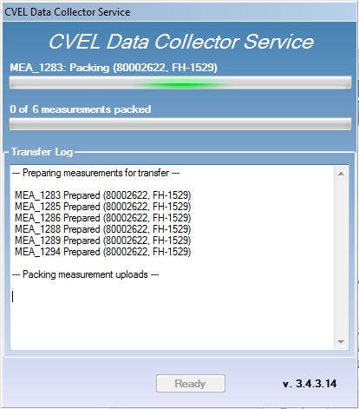
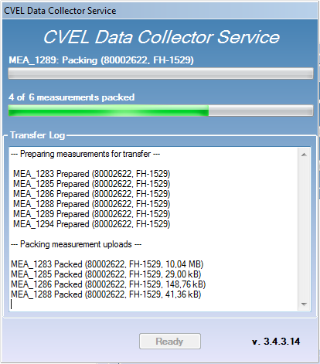
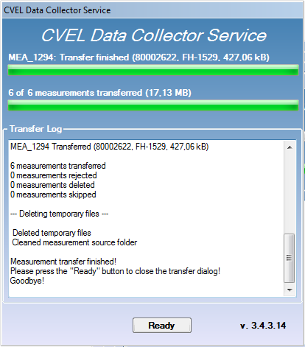
eFACTS Collector – data upload
1
2
--- Preparing measurements for transfer ---
MEA_1283 Prepared (80002622, FH-1529)
MEA_1285 Prepared (80002622, FH-1529)
MEA_1286 Prepared (80002622, FH-1529)
MEA_1288 Prepared (80002622, FH-1529)
MEA_1289 Prepared (80002622, FH-1529)
MEA_1294 Prepared (80002622, FH-1529)
--- Packing measurement uploads ---
MEA_1283 Packed (80002622, FH-1529, 10,04 MB)
MEA_1285 Packed (80002622, FH-1529, 29,00 kB)
MEA_1286 Packed (80002622, FH-1529, 148,76 kB)
MEA_1288 Packed (80002622, FH-1529, 41,36 kB)
MEA_1289 Packed (80002622, FH-1529, 6,46 MB)
MEA_1294 Packed (80002622, FH-1529, 427,06 kB)
3
4
--- Transferring measurement uploads ---
MEA_1283 Transferred (80002622, FH-1529, 10,04 MB)
MEA_1285 Transferred (80002622, FH-1529, 29,00 kB)
MEA_1286 Transferred (80002622, FH-1529, 148,76 kB)
MEA_1288 Transferred (80002622, FH-1529, 41,36 kB)
MEA_1289 Transferred (80002622, FH-1529, 6,46 MB)
MEA_1294 Transferred (80002622, FH-1529, 427,06 kB)
6 measurements transferred
0 measurements rejected
0 measurements deleted
0 measurements skipped
--- Deleting temporary files ---
Deleted temporary files
Cleaned measurement source folder
Measurement transfer finished!
Please press the "Ready" button to close the transfer dialog!
Goodbye!

Slide 20
eFACTS Collector - Transfer info Where data could be found if error/warning
Rejected – C:\eFACTS\Collector\Rejected
Unknown Traffic – The GUID of the CAN traffic recording is not in our list of known storage groups
Unknown Storage Group– The GUID of the storage group is not in our list of known storage groups
Event Files Mismatch – The number of different files does not match the number of events in the measurement
Event file size error – The files size for the events are incorrect
No Uploads – The measurement was not recognized
Cannot extract split ZIP file – The MEA-package is split into several zip-files
Deleted – Can only be restored from USB stick
Copy Detected – A copy of the CAN traffic already exists in the database
SG Copy Detected – A copy of the signal recording already exists in the database
Skipped – C:\MeasData
Ftp Upload Error– The FTP upload was unsuccessful
Database Error – Data could not be written to database
No Vehicle To Logger Binding – No binding could be found for the measurement
Invalid Vehicle To Logger Binding – The transfer was aborted by user, due to incorrect binding
Unknown Error – Unknown error during transfer (i.e. file read error or network error)

Slide 21
eFACTS Refiner – Test Leader analysis

Slide 22

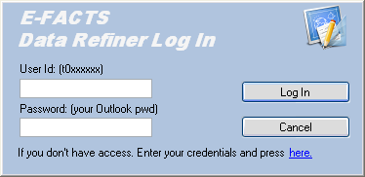
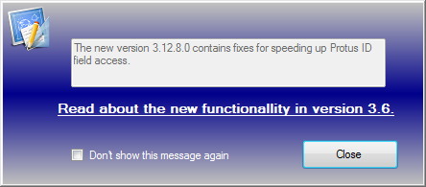
eFACTS Data Refiner
Credentials needed: if no access, enter your ID and Outlook password then click on the request access link (here) /!\ Training required before access is granted /!\
When access is granted, an information window appears that displays new functional features Click Close to continue

Slide 23
eFACTS Data Refiner – Definitions
Measurement
A measurement starts automatically when the system starts.
A measurement consists of one or several ”Events”.
A saved measurement is represented in the logger by 2 files,
MEA_xxx.zip and LOG_xxx.zip. (xxx=sequential number)
Event
An Event consists of one trigger start/stop activation.
Every time the button is pressed an Event is started.

Slide 24
eFACTS Data Refiner – Definitions
An event status can be : - New / Unfinished - Discarded - Check-in Pending - Checked-in - Loaded from database
New / Unfinished: Needs to be handled by the TL/TE, will be deleted after 30 days, from when the event was logged in the vehicle.
Discarded: - by the system in case of Autotraffic measurements (e.g. Safety) - by the TE/TL if the event is considered as not relevant
Check-in Pending: Handled by TE/TL, ready to be checked-in
Checked-in: event has already been completely handled and downloaded into the database
Loaded from database: event uploaded from the database

Slide 25
eFACTS Data Refiner – Icon Bar
Load MEAs: Look for a measurement on the server, before they are checked-in or discarded
Load From DB: Load some already ”Checked In” events
Pending Check In: To Check In all pending events
UDS Viewer: Will be used to check SW/HW versions of the truck
Assist Me: To get some help from troubleshooters, sends data without using PROTUS.
More Event Info: Specific Info about an event, like GPS map
PROTUS Link: Link generation to be put into PROTUS reports
Reports: For PVT team, PVT reports generation. May be used to get an overview of a specific truck and SW package.
Statistics: Global info about eFACTS
Help: Complete documentation + mail to eFACTS support

Slide 26
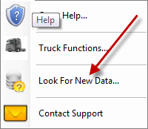
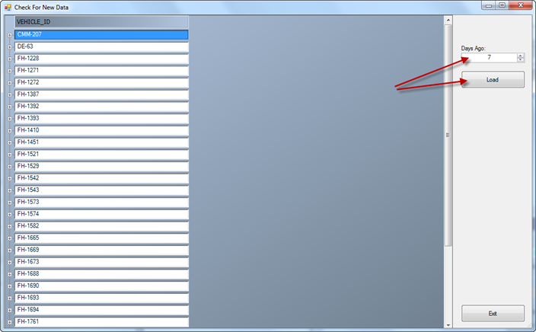
eFACTS Data Refiner – New Data
Ths feature enable to see if any Remote or USB data has been uploaded
If you can’t find your data using the instruction below, contact ”TT GOT”
Select the number of ”Days Ago” and press ”Load”
Select ”Look for New Data”

Slide 27
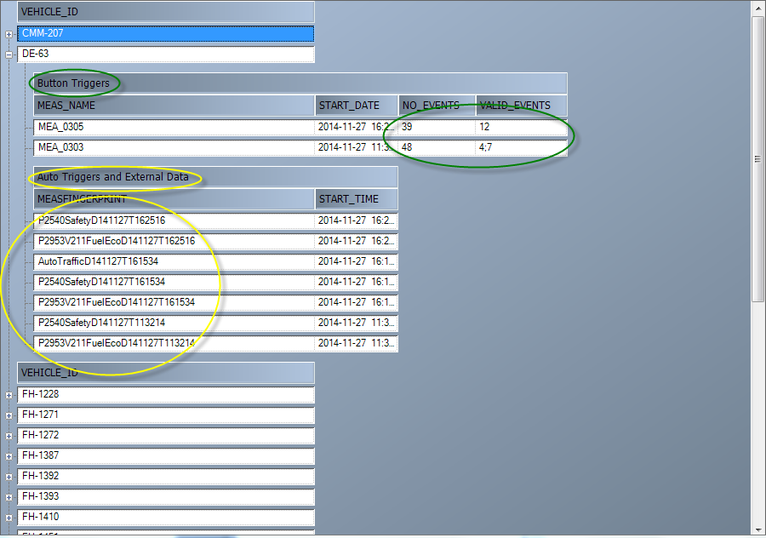
eFACTS Data Refiner – New Data
Example:
Last data that was uploaded, was recorded 2014-11-27
Button Trigger exists in MEA_0303 and 0305.
0303 – contains 48 events(BT and auto), only event 4+7 are button triggered
0305 – contains 39 events, no 12 is BT triggered
External data has been uploaded
E.g. P2540safety triggered data and FuelEco data

Slide 28

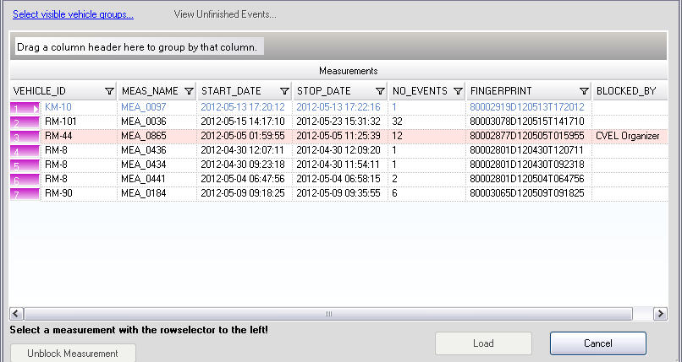
eFACTS Data Refiner – Loading MEAs
Click on Select Visible Group to get your vehicles (LYS, GOT etc).
View Unfinished Events: Events which have not been handled yet, works when a MEA file is selected for a specific truck
Unlock Measurements: Locked MEAs appear in red and can only be unlocked by their originator or the administrator.
Select MEAs as told (rowselector) and Click Load NB: you can filter data by drag-and-dropping column headers.
It can take time for your measurements to be available (up to 1h, depending on the system load). If longer, e-mail support.

Slide 29
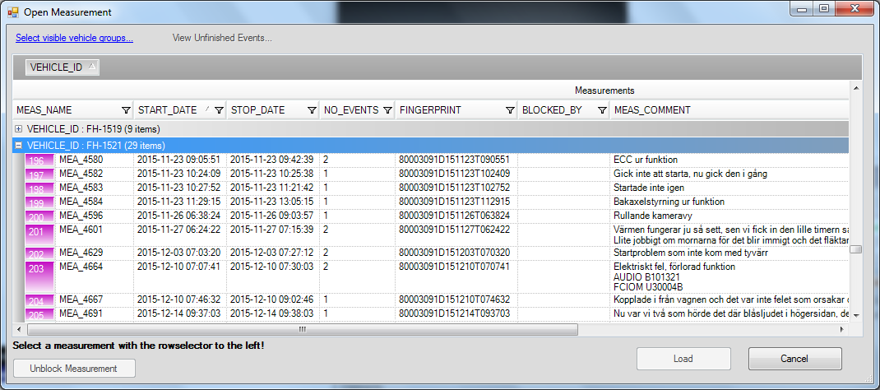
eFACTS Data Refiner – Loading MEAs
Every user can have their own filtering, for the vehicles you want to see. This filtering will be stored and re-used.

Slide 30
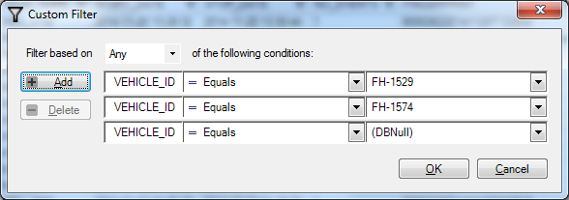
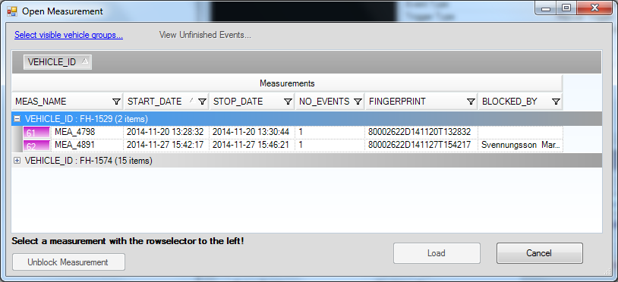
eFACTS Data Refiner – Loading MEAs
Add condition: Any = OR, All = AND
To Delete filter, click on any field on that row and press Delete
Example after filtering and also by using ”Vehicle_ID” Grouping

Slide 31
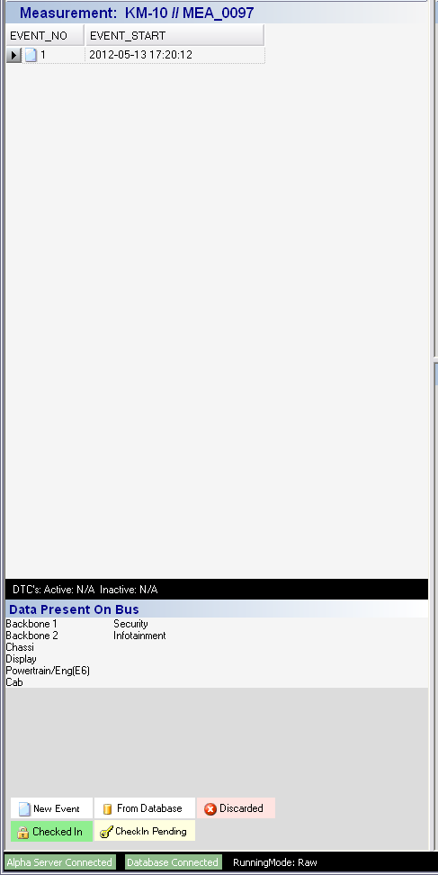
eFACTS Data Refiner – Events
Measurement name
List of Events
Recorded CAN buses (extracted only from the first event in the MEA-package)
Legend for events icons
Connection status to the server

Slide 32
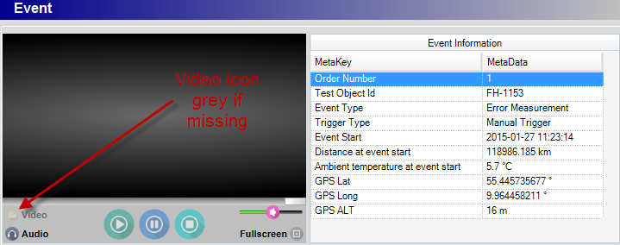
eFACTS Data Refiner – Event Info
Event metadata presentation for the selected event
Video and audio will be played syncronized, if available
Scrolling is possible, ”Full screen” only if video available
Manual Trigger = Button pressed

Slide 33
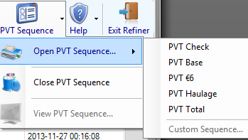
eFACTS Data Refiner PVT Sequence (PVT Team)
By Loading a pre-defined sequence or a Custom sequence, it is possible to bind a Test Case to the event.
If no Test Case, then ”OFD” can be selected
The Test Case list will follow the selected sequence
For each test case, you can access a list of typical errors and dedicated comments you can directly paste into the Refiner main window:

Slide 34
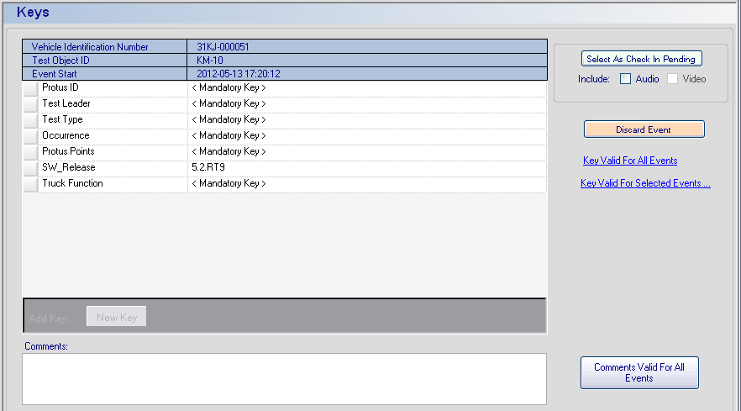
eFACTS Data Refiner – Keys
Several mandatory keys
Crucial part of the system, to find events and create reports
Pending = ready for being checked-in in the database
Key Valid for ... Events : copy/paste keys for the events in the MEA /!\ Everything added is recorded! Don’t mess with data Keys are lost when leaving
Comments: Always stored.

Slide 35
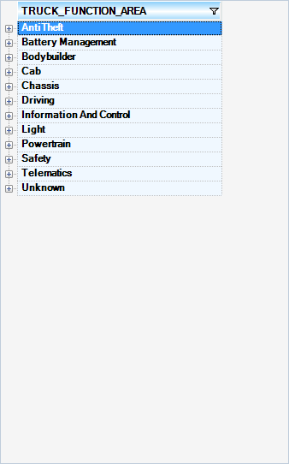
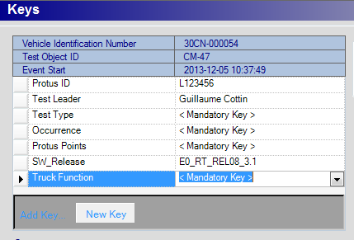
eFACTS Data Refiner – Keys - Truck Function and Test Type
When creating Keys – The ”Truck Function” list will now be filtered based on Product Class
(Functions not avaliable in the vehicle, will not be seen.)
”Test Type”, ”Test Leader” and ”SW_Release”data will come from the Collector Vehicle/Logger binding

Slide 36
eFACTS Data Refiner – Keys
PROTUS ID: report no where the link will be - name must be correct ! LXXX (not lxxx) - no spaces before or after the Lxxx number - no additional zeros... - several events can be linked to the same PROTUS
You can Add and have several PROTUS to one Event.
Test Type: Field Test, PVT, AET, RT...
Ocurrence: Rarely/ Once / Often / Every Time
SW release: BaselineBranch_PC_week_version (e.g. P0P1_24_w1623_2.1)

Slide 37
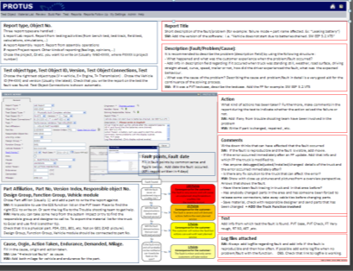
eFACTS Data Refiner – Keys
PROTUS Points:
Follow PROTUS Guidelines + GDI 968-50: http://violin.volvo.net/SiteCollectionDocuments/Powertrain/VPT%20G%C3%B6teborg/projects%20and%20processes/PROTUS/GDI968-50%5B1%5D.pdf

Slide 38
eFACTS Data Refiner – Keys
The complete TF list can be found under Help -> Truck Function menu of the Refiner
The Truck Function list you get when working on a particular event, will depend from the Product Class your test truck belongs to.
Notify ”Support E-FACTS” if a Truck Function is missing.

Slide 39
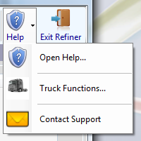
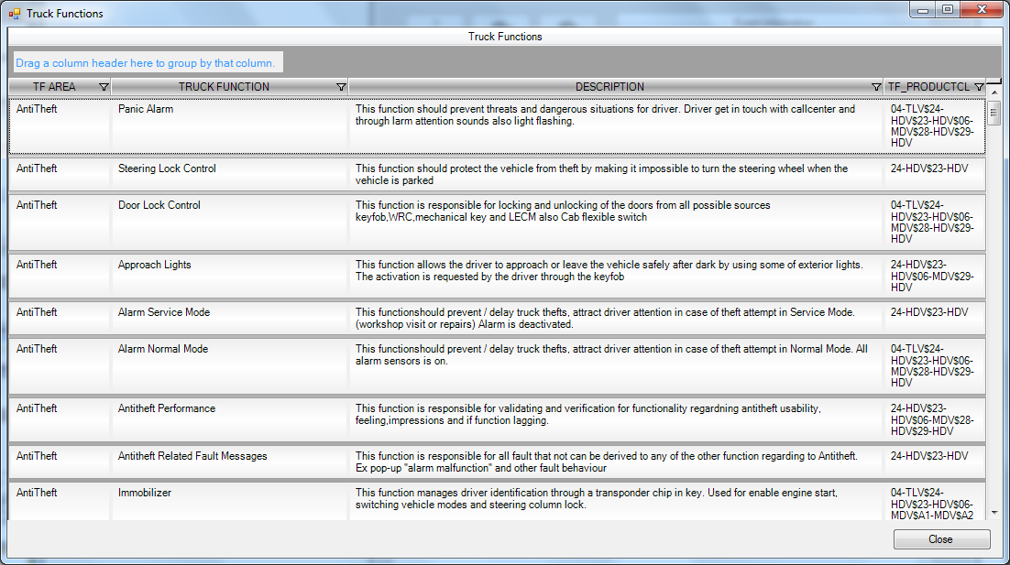
eFACTS Data Refiner – Truck Function List
Drag header to organize
Possible to use filter by clicking on filtersymbol
All Truck Functions

Slide 40

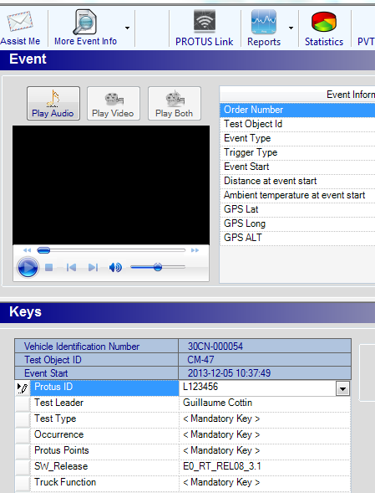
eFACTS Data Refiner – PROTUS Key
PROTUS link not available at startup
Work flow:
Load Measurement
Listen to events
If PROTUS - create PROTUS first
Enter the PROTUS-id as key
Press ”PROTUS Link” --> (Link will be created based on value entered in PROTUS-id key)

Slide 41

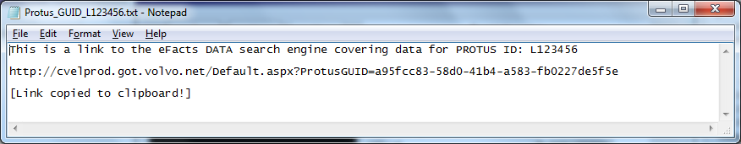
eFACTS Data Refiner – PROTUS Link
The PROTUS link created will be based on the PROTUS ID that was entered as the PROTUS key value.
The http link is already in the clipboard and can now be paste into the url-link (folder Documents) in PROTUS (see next slide).
The link needs to be created only once for each PROTUS report. If the same issue has already been detected in the truck, just select the correct report number in the PROTUS ID Key. (When engineering later clicks on the link, all the different logged events for that PROTUS will appear.)
The PROTUS link will not work until you have ”Checked In” the pending events to the database and could take some minutes (try the link).

Slide 42
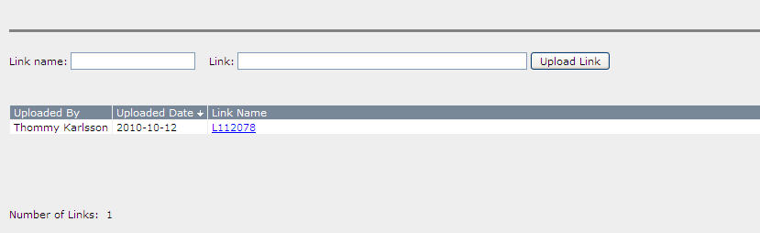
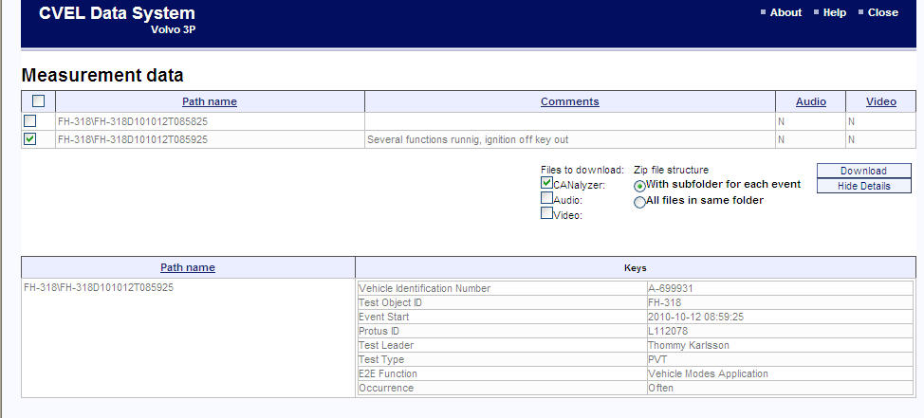
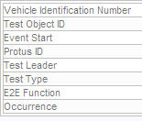
Give same ”Link name” as PROTUS no
PROTUS link
Paste http-link
Result after ”Upload Link”
http://cveldata.got.volvo.net/Default.aspx?PROTUSGUID=7d521104-a737-4e68-9f74-924d098b0a4b
Encrypted PROTUS Id
Example, if clicking on Link above

Slide 43
My responsibilities as TE/TL
Check/update - logger/vehicle binding in Collector
Transfer the data from the logger to the server.
Check-in Events to the database with appropriate keys attached, within 30 days after the log event was taken in the vehicle.
Discard invalid events!
Link the data to a PROTUS report.

Slide 44
eFACTS – Checklist - 1
Log the problems about the truck by pressing the button AND giving an audio feedback
Retrieve data from the M-LOG datalogger with the USB stick.
In the Collector service, check the correct binding between the M-LOG and the Truck no.
Copy data (8000xxxx folder) to the C:\MeasData folder .
Thanks to the eFACTS Collector service, upload data to the server.

Slide 45

eFACTS – Checklist - 2
Open the eFACTS Data Refiner and: - Wait for the database to be updated with latest data (can take up to 1h). - Check-in or Discard each event - In the same time, create the PROTUS report for checked-in events.
Generate the PROTUS Link and put it into the Documents tab of the PROTUS report
Don’t forget to Click to check-in your pending events (could take time)

